Slide 1
2D TRANSFORMATION
Yalin Wang

Slide 2

Disclaimer
These slides can only be used as study material for the class 411 at ASU
The slides cannot be distributed or used for another purpose
The slides may contain errors
The slides do not contain all the information necessary to succeed in class; additional material from the book must to be studied
The slides are based on a lecture from Prof. Purgathofer from the Vienna University of Technology

Slide 3
Basic Transformations: Translation
translating a point from position P to position P’ with translation vector T
P´
x
′
=
x
+
t
y
′
=
y
+
t
x
y
T
P
P
′
=
P
+
T
⎛
x
⎞
⎛
x
′
⎞
⎛
t
⎞
notation:
P
=
⎜
⎟
,
P
′
=
⎜
⎟
,
T
=
⎜
x
⎟
⎜
⎟
⎝
y
⎠
⎝
y
′
⎠
t
⎝
⎠
y

Slide 4

Basic Transformations: Translation
rigid body transformation
  object transformed by transforming boundary points
P₃
T
P₂
P₁

Slide 5
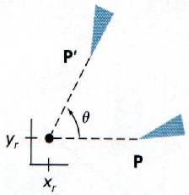
Basic Transformations: Rotation
rotation of an object through angle θ about the pivot point (x_{r}, y_{r})

Slide 6
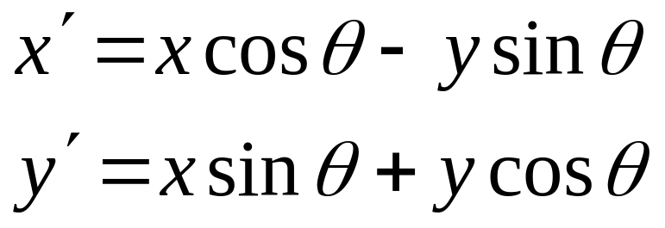
Basic Transformations: Rotation
positive angle ⇒ ccw rotation
x = r.cosφ
y = r.sinφ
(x´,y´)
x’ = r.cos(φ + θ)
r
= r.cosφ.cosθ − r.sinφ.sinθ
= r.cosφ.cosθ − r.sinφ.sinθ
(x,y)
= x .cosθ − y .sinθ
r
θ
y’ = r.sin(φ + θ)
φ
= r.cosφ.sinθ + r.sinφ.cosθ
= r.cosφ.sinθ + r.sinφ.cosθ

Slide 7
Basic Transformations: Rotation
formulation with a transformation matrix
x
′
=
x
cos
θ
−
y
sin
θ
y
′
=
x
sin
θ
+
y
cos
θ
⎛
cos θ
−sin θ
⎞
P
′
=
R
⋅
P
with
R
=
⎜
⎟
⎝
sin θ
cos θ
⎠
⎛
cos θ
−sin θ
⎞
⎛
x
⎞
⎛
x
cos
θ
−
y
sin
θ
⎞
R⋅P
=
⎜
⎟
⋅
⎜
⎟
=
⎜
⎟
⎝
sin θ
cos θ
⎠
⎝
y
⎠
⎝
x
sin
θ
+
y
cos
θ
⎠

Slide 8
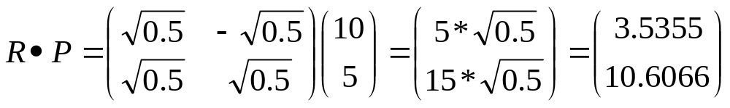
Basic Transformations: Rotation Example
P with x = 10 and y = 5 is rotated θ = 45 degrees
What is the rotation matrix R?
What is R*P?

Slide 9
Basic Transformations: Scaling
x
′
=
x
⋅
s
,
y
′
=
y
⋅
s
P
x
y
⎛
x
′
⎞
⎛
s
0
⎞
⎛
x
⎞
⎜
⎟
=
⎜
x
⎟
⋅
⎜
⎟
⎜
⎟
⎝
y
′
⎠
0
s
⎝
y
⎠
⎝
⎠
y
S
P´= S ⋅ P
P´
example: a line scaled using s_{x}=s_{y}=0.33 is reduced in size and moved closer to the coordinate origin

Slide 10
Basic Transformations: Scaling
uniform scaling: s_{x}=s_{y}
differential scaling: s_{x}≠s_{y}
fixed point:
(x_{f}, y_{f})

Slide 11
Transformation Matrices
⎛
x
′
⎞
⎛
s
0
⎞
⎛
x
⎞
scaling
rotation
x-mirroring
translation
⎜
⎟
=
⎜
x
⎟
⋅
⎜
⎟
′
⎜
⎟
⎝
y
⎠
⎝
0
s
⎠
⎝
y
⎠
y
⎛
x
′
⎞
⎛
cos θ
−sin θ
⎞
⎛
x
⎞
⎜
⎟
=
⎜
⎟
⋅
⎜
⎟
⎝
y
′
⎠
sin θ
cos θ
⎝
y
⎠
⎝
⎠
⎛
x
′
⎞
⎛
1
0
⎞
⎛
x
⎞
⎜
⎟
=
⎜
⎟
⋅
⎜
⎟
′
⎜
⎟
⎝
y
⎠
⎝
0
−1
⎠
⎝
y
⎠
(
x
'
y
'
)
=
(
x
+
d
x
,
y
+
d
y
)
... ? Problem!!

Slide 12
Homogeneous Coordinates (1)
⎛
x_{h}
⎞
⎛
x
⎞
instead of
⎜
⎟
use
⎜
⎟
with x = x_{h}/h, y = y_{h}/h
y_{h}
⎝
y
⎠
⎜
⎟
⎜
h
⎟
⎝
⎠
x
⎛
⎞
very often h=1, i.e.
⎜
⎟
y
⎜
⎟
⎜
1
⎟
⎝
⎠
in this way all transformations can be
formulated in matrix form

Slide 13
Homogeneous Coordinates (2)
translation
rotation
scaling
⎛
x
′
⎞
⎛
1
0
t
⎞
⎛
x
⎞
⎜
⎟
⎜
x
⎟
⎜
⎟
′
=
⋅
y
′
=
0
1
t
⋅
y
P
T
(
t
,
t
)
P
⎜
⎟
⎜
⎟
⎜
⎟
x
y
⎜
⎟
⎜
y
⎟
⎜
⎟
⎝
1
⎠
⎝
0
0
1
⎠
⎝
1
⎠
⎛
x
′
⎞
⎛
cos
θ
−
sin
θ
0
⎞
⎛
x
⎞
⎜
⎟
⎜
⎟
⎜
⎟
⎜
y
′
⎟
=
⎜
sin
θ
cos
θ
0
⎟
⋅
⎜
y
⎟
P
′
=
R
(
θ
)
⋅
P
⎜
⎟
⎜
⎟
⎜
⎟
⎝
1
⎠
⎝
0
0
1
⎠
⎝
1
⎠
⎛
x
′
⎞
⎛
s
0
0
⎞
⎛
x
⎞
⎜
⎟
⎜
x
⎟
⎜
⎟
⎜
y
′
⎟
=
⎜
0
s
0
⎟
⋅
⎜
y
⎟
P
′
=
S
(
s
,
s
)
⋅
P
⎜
⎟
⎜
y
⎟
⎜
⎟
x
y
⎝
1
⎠
⎝
0
0
1
⎠
⎝
1
⎠

Slide 14
Inverse Matrices
translation
rotation
scaling
T
−
1
(
t
,
t
)
=
T
(
−
t
,
−
t
)
x
y
x
y
R
−
1
(
θ
)
=
R
(
−
θ
)
S
−
1
(
s
,
s
)
=
S
(
1
/
s
,
1
/
s
)
x
y
x
y

Slide 15
Composite Transformations (1)
n transformations are applied after each other on a point P, these transformations are represented by matrices M₁, M₂, ..., M_{n}.
P’ = M₁⋅P
P’’ = M₂⋅P’
...
P^{(n)} = M_{n}⋅P ^{(n-1)}
shorter: P^{(n)} = (M_{n}⋅ ...(M₂⋅(M₁⋅P) ) ... )

Slide 16
Composite Transformations (2)
P^{(n)} = (M_{n}⋅ ... (M₂⋅(M₁⋅P) ) ... )
matrix multiplications are associative:
(
M
·
M
)
·
M
=
M
·
(
M
·
M
)
1
2
3
1
2
3
(but not commutative: M₁⋅M₂ ≠ M₂⋅M₁ )

Slide 17
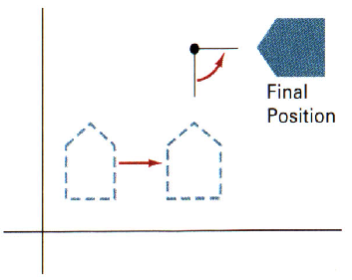
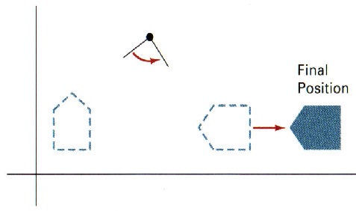
Transformations are not commutative!
Reversing the order in which a sequence of transformations is performed may affect the transformed position of an object. In (a), an object is first translated, then rotated. In (b), the object is rotated first, then translated.
(a)
(b)

Slide 18
Composite Transformations (2)
P^{(n)} = (M_{n}⋅ ... (M₂⋅(M₁⋅P) ) ... )
matrix multiplications are associative:
(
M
·
M
)
·
M
=
M
·
(
M
·
M
)
1
2
3
1
2
3
(but not commutative: M₁⋅M₂ ≠ M₂⋅M₁ )
therefore the total transformation can also be written as: P^{(n)} = ( M_{n}⋅ ... ⋅M₂⋅M₁ ) ⋅P
M_{n}⋅ ... ⋅M₂⋅M₁
constant for whole images, objects, etc.!!!

Slide 19
Composite Transformations (3)
simple composite transformations
composite translations
composite rotations
composite scaling
T
(
t
,
t
)
⋅
T
(
t
,
t
)
=
T
(
t
+
t
,
t
+
t
)
x
2
y
2
x
1
y
1
x
1
x
2
y
1
y
2
R
(
θ
)
⋅
R
(
θ
)
=
R
(
θ
+
θ
)
2
1
1
2
S
(
s
,
s
)
⋅
S
(
s
,
s
)
=
S
(
s
⋅
s
,
s
⋅
s
)
x
2
y
2
x
1
y
1
x
1
x
2
y
1
y
2

Slide 20
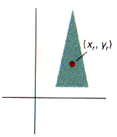
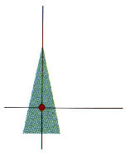
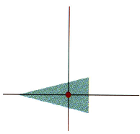
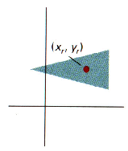
Composite Transformations (4)
general pivot-point rotation
T
(
x
,
y
)
⋅
R
(
θ
)
⋅
T
(
−
x
,
−
y
)
=
R
(
x
,
y
,
θ
)
r
r
r
r
r
r
original position and pivot point
translation of object so that pivot point is at origin
rotation about origin
translation so that the pivot point is returned

Slide 21
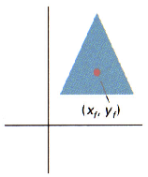
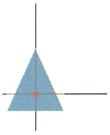
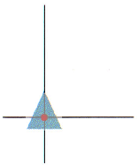
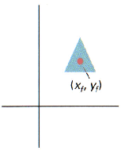
Composite Transformations (5)
general fixed-point scaling
T
(
x
,
y
)
⋅
S
(
s
,
s
)
⋅
T
(
−
x
,
−
y
)
=
S
(
x
,
y
,
s
,
s
)
f
f
x
y
f
f
f
f
x
y
original position and fixed point
translate object so that fixed point is at origin
scale object with respect to origin
translate so that the fixed point is returned

Slide 22
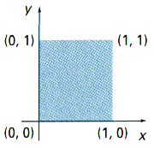
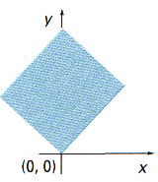
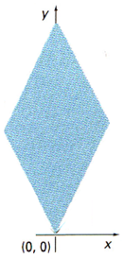
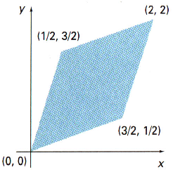
Composite Transformations (6)
general scaling directions
R
−
1
(
θ
)
⋅
S
(
s
,
s
)
⋅
R
(
θ
)
1
2
original position
after 45° rotation
rotate back
with - 45 °
after (1,2) scalation

Slide 23
example: translate by (3,4), then rotate by 45°
and then scale up by factor 2 in x-direction
⎛
1
0
3
⎞
1. M₁ = T(3,4) =
⎜
⎟
⎜
0
1
4
⎟
⎜
0
0
1
⎟
⎝
⎠
⎛
cos 45
−sin 45
0
⎞
2. M₂ = R(45°) =
⎜
⎟
⎜
sin 45
cos 45
0
⎟
⎜
⎟
⎝
0
0
1
⎠
⎛
2
0
0
⎞
3. M₃ = S(2,1) =
⎜
⎟
⎜
0
1
0
⎟
⎜
0
0
1
⎟
⎝
⎠
M = M₃ ⋅ M₂ ⋅ M₁

Slide 24
example: translate by (3,4), then rotate by 45° and then scale up by factor 2 in x-direction
M = M₃ ⋅ M₂ ⋅ M₁
=
⎛
2
0
0
⎞
⎛
cos 45
−sin 45
0
⎞
⎛
1
0
3
⎞
=
⎜
⎟
⎜
⎟
⎜
⎟
=
0
1
0
⋅
sin 45
cos 45
0
⋅
0
1
4
⎜
⎟
⎜
⎟
⎜
⎟
⎜
0
0
1
⎟
⎜
0
0
1
⎟
⎜
0
0
1
⎟
⎝
⎠
⎝
⎠
⎝
⎠
⎛
2
0
0
⎞
⎛
cos 45
−sin 45
3cos 45 − 4sin 45
⎞
=
⎜
⎟
⎜
⎟
=
0
1
0
⋅
sin 45
cos 45
3sin 45 + 4cos 45
⎜
⎟
⎜
⎟
⎜
0
0
1
⎟
⎜
0
0
1
⎟
⎝
⎠
⎝
⎠
⎛
2cos 45
−2sin 45
6cos 45 − 8sin 45
⎞
=
⎜
⎟
⎜
sin 45
cos 45
3sin 45 + 4cos 45
⎟
⎜
0
0
1
⎟
⎝
⎠

Slide 25
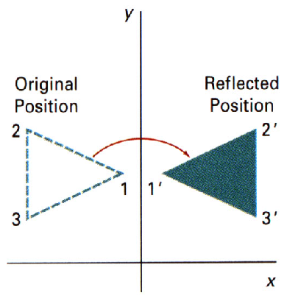
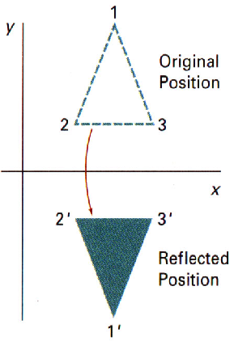
Reflection
about y-axis:
Rf_{y}=
about x-axis:
⎛
−
1
0
0
⎞
⎛
1
0
0
⎞
⎜
⎟
⎜
⎟
0
1
0
Rf_{x}=
0
−
1
0
⎜
⎟
⎜
⎟
⎜
⎟
⎜
⎟
⎝
0
0
1
⎠
⎝
0
0
1
⎠
Peter Wonka

Slide 26



example: reflection about the axis with angle α
=
α

Slide 27











Reflection about α-axis
1. rotation by −α
2. mirroring about x-axis
3. rotation by +α
=
α
1
.
2
.
3
.
+
+
−
α
+
α

Slide 28
example: reflection about the axis with angle α
⎛
cos(−α)
−sin(−α)
0
⎞
1
.
1. M₁ = R(−α) =
⎜
⎟
⎜
sin(−α)
cos(−α)
0
⎟
⎜
⎟
⎝
0
0
1
⎠
⎛
1
0
0
⎞
2. M₂ = S(1,−1) =
⎜
⎟
2
.
⎜
0
−1
0
⎟
⎜
0
0
1
⎟
⎝
⎠
⎛
cosα
−sinα
0
⎞
3. M₃ = R(α) =
⎜
⎟
sinα
cosα
0
3
.
⎜
⎟
⎜
⎟
⎝
0
0
1
⎠
P’ = M₃ ⋅ ( M₂ ⋅ ( M₁ ⋅ P ) ) = ( M₃ ⋅ M₂ ⋅ M₁ ) ⋅ P

Slide 29
example: reflection about the axis with angle α
M₃ ⋅ M₂ ⋅ M₁ =
⎛
cosα
−sinα
0
⎞
⎛
1
0
0
⎞
⎛
cos(−α)
−sin(−α)
0
⎞
⎜
⎟
⎜
⎟
⎜
⎟
=
sinα
cosα
0
⋅
0
−1
0
⋅
sin(−α)
cos(−α)
0
=
⎜
⎟
⎜
⎟
⎜
⎟
⎜
0
0
1
⎟
⎜
0
0
1
⎟
⎜
0
0
1
⎟
⎝
⎠
⎝
⎠
⎝
⎠
⎛
cosα
sinα
0
⎞
⎛
cosα
sinα
0
⎞
⎜
⎟
⎜
⎟
=
sinα
−cosα
0
⋅
−sinα
cosα
0
=
⎜
⎟
⎜
⎟
⎜
0
0
1
⎟
⎜
0
0
1
⎟
⎝
⎠
⎝
⎠
⎛
cos²α−sin²α
2sinαcosα
0
⎞
⎛
cos2α
sin2α
0
⎞
⎜
⎟
⎜
⎟
=
2sinαcosα
sin²α−cos²α
0
=
sin2α
−cos2α
0
⎜
⎟
⎜
⎟
⎜
0
0
1
⎟
⎜
0
0
1
⎟
⎝
⎠
⎝
⎠

Slide 30
Computational Efficiency
general two-dimensional transformation
⎛
x
′
⎞
⎛
rs
rs
trs
⎞
⎛
x
⎞
⎜
⎟
⎜
xx
xy
x
⎟
⎜
⎟
y
′
=
rs
rs
trs
⋅
y
⎜
⎟
⎜
⎟
⎜
⎟
yx
yy
y
⎜
⎟
⎜
⎟
⎜
⎟
⎝
1
⎠
⎝
0
0
1
⎠
⎝
1
⎠
x
′
=
x
⋅
rs
+
y
⋅
rs
+
trs
xx
xy
x
y
′
=
x
⋅
rs
+
y
⋅
rs
+
trs
yx
yy
y

Slide 31
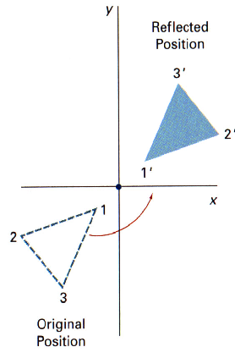
Other Transformations:
Reflection about a point
reflection about origin
Rf_{O} (=R(180º)) =
⎛
−
1
0
0
⎞
⎜
⎟
⎜
0
−
1
0
⎟
⎜
⎟
⎝
0
0
1
⎠

Slide 32
Reflection with respect to a general line
reflection with respect to the line y=mx+b
T(0,b) ⋅ R(θ) ⋅ Rf_{x} ⋅ R(−θ) ⋅ T(0,-b)
m = tan(θ)

Slide 33
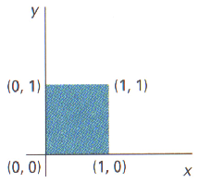
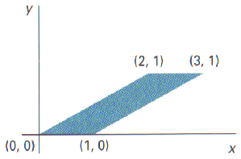
Other Transformations: Shear (1)
x-direction shear
  along x-axis
  reference line y=0
⎛
1
sh
0
⎞
⎜
x
⎟
⎜
0
1
0
⎟
⎜
⎟
⎝
0
0
1
⎠

Slide 34
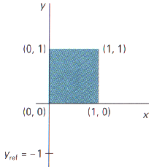
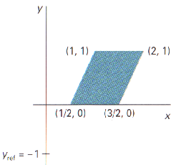
Other Transformations: Shear (2)
general x-direction shear
  along x-axis
  reference line y=y_{ref}
−
⋅
⎛
1
sh
sh
y
⎞
⎜
x
x
ref
⎟
⎜
0
1
0
⎟
⎜
⎟
⎝
0
0
1
⎠

Slide 35
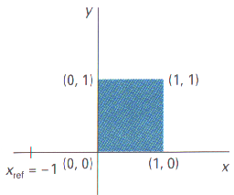
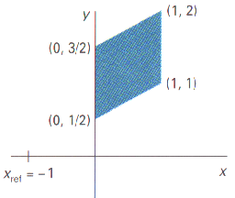
Other Transformations: Shear (3)
general y-direction shear
  along y-axis
  reference line x=x_{ref}
⎛
1
0
0
⎞
⎜
⎟
⎜
sh
1
−
sh
⋅
x
⎟
⎜
y
y
ref
⎟
⎝
0
0
1
⎠
Peter Wonka

Slide 36
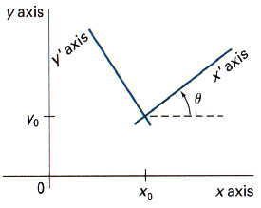
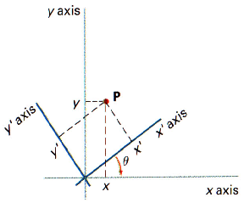
Transf. betw. Coordinate Systems
M
=
R
(
−
θ
)
⋅
T
(
−
x
,
−
y
)
xy
,
x
′
y
′
0
0
A Cartesian x’y’ system positioned at (x₀,y₀) with orientation θ in an xy Cartesian system
Position of the reference frames after translating the origin of the x’y’ system to the coordinate origin of the xy system
Peter Wonka

Slide 37
Affine Transformations
x
′
=
a
x
+
a
y
+
b
xx
xy
x
y
′
=
a
x
+
a
y
+
b
yx
yy
y
parallel lines ⇒ parallel lines
finite points ⇒ finite points
any affine transformation is combination of translation, rotation, scaling, reflection, shear
affine transformation consisting of translation, rotation, reflection only:
  angle, length preserving
demo

